Slide 1
Evaluation of the Slovak Action Plan for Cluster Support Policy Improvement Artur Bobovnický - Vladimír Borza - Renáta Magulová - Alexandra Vavrdová & Peter Adamovský
ClusterFY Partner Meeting in Groningen, 12.-14. September 2022

Slide 2
THE BACKGROUND
The Slovak Action Plan for Cluster Organization Support Policy Improvement was approved on 17th December 2019. The aim of the Action Plan were improvements in the Policy Measure Scheme DM 18/2014 (Scheme to promote industrial cluster organizations).
The main goal was to minimize and remove of barriers and lower the obstacles that are preventing clusters and SMEs from collaborating with other business, academic and R&D institutions, increasing their ability to internationalize and increase their competitive position in wider European marketplace.
The Policy Instrument was focused formally on well-established clusters mainly those high-tech oriented and internationally known & newly established clusters operating in less developed region.

Slide 3
PROS & CONS of the Scheme
The following activities were supported with this scheme:
• training organized by industrial clusters or education of its members;
• presentations of industrial clusters and their members locally and abroad through participation in exhibitions;
• development of industrial clusters strategies;
• expert consultation activities;
• clusters participation in international projects and networks.
The Scheme was not supporting regular operation of cluster and was not directly linked with any evaluation scheme measuring the progress of cluster in achieving its goals.

Slide 4
NEW FOCUS - based on international experience
Based on international experiences and learning from project partners, SIEA focused its efforts:
on setting of new National Cluster Assessment System
to systematic clusters certification/evaluation and subsequent measurements of cluster progress,
the achieved improvement to use for motivation for new cluster establishing and raising of awareness of clusters in society,
adjusting the policy to stress performance based on funding.

Slide 5
OUTPUTS AND RESULTS
Establishment of the Cluster Stakeholder Working Group (CSWG)
Regular stakeholder meetings of the ClusterFY project, gradually extended by representatives of the Ministry of the Economy (MoE), Slovak Business Agency, Cluster Union of the Slovak Republic and important high-developed clusters, were transformed into the Cluster Stakeholder Working Group.
This Group meets once in three months in form of "Cluster mornings in SIEA" (during the project approx. 18 times). In addition to the issue of ClusterFY, other cluster topics were also on the programme – preparation methodological, strategic and various positional documents (for example criteria of the National Cluster Assessment, update Scheme DM, etc.).

Slide 6
OUTPUTS AND RESULTS
In the framework of ClusterFY were prepared conditions for the Support Scheme from the Operational Programme Integrated Infrastructure – grants for clusters in the Bratislava self-governing region with total allocation 2.3 mil. EUR and in other regions of Slovakia with total allocation 2.7 mil. EUR. Number of approved or contracted projects: 21.
In this Scheme, the important change was achieved by evaluation of cluster performance and assessment of the efficiency of funds invested in support of cluster development. Involvement of ESCA Certification Reports into the performance goals could be a natural way how to establish a basis for measuring impact. (Reports are providing deep, independent view onto the Cluster management functioning, stating the weakness and providing some recommendations, too.). Wages and operating costs were also included among the eligible costs.

Slide 7
OUTPUTS AND RESULTS
Preparation of an updated version of the DM Scheme for the Support of Industrial Cluster Organizations 2022 - 2023 (DM 6/2022, support from the state budget). The scheme is designed for clusters in early stage of development up to three years of existence. The amount of the subsidy is max. 85% of the project's eligible expenses. An important condition for the applicants is the passing through the National evaluation process by SIEA. Available funds allocated for this Call are 250,000 EUR.
Participation in survey: „COVID19 impact on clusters: needs, challenges and recovery process”.

Slide 8
Benefits of the ClusterFY project for the Slovak cluster ecosystem
For Slovakia, this project had a significant benefit, which manifested itself in the creation of two above mentioned support schemes, in the intensification of "cluster life" &
on the national level by creation of National Cluster Assessment System, Cluster Stakeholder Working Group (CSWG) and information platform – Slovak Cluster Monitor
in growth of interest of companies to network in the form of clusters (establishment of 10 new clusters),
in a higher degree of internationalization of cluster organizations,

Slide 9
Benefits of the ClusterFY project for the Slovak cluster ecosystem
The increase of the cluster registration on the ECCP platform,
In higher number of clusters certified by ESCA,
in positive outputs within networking activities of the B2B, C2C, B2C type (for example: Mazowiecky cluster vs. Košice IT Valley),
in higher professionalization of the SIEA cluster team.

Slide 10
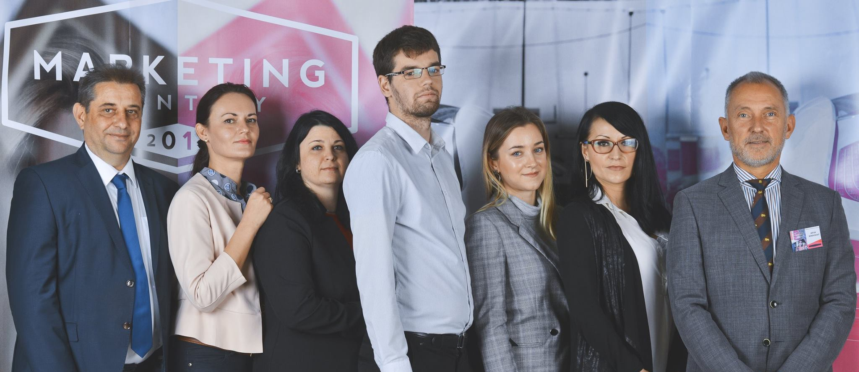
DISCUSSION
Thank you for your attention
Q & A
SIEA Cluster Expert Team

